Slide 1
Integration of Experimental Propulsion Systems in Micro Air Vehicles
Midpoint Presentation
February 22, 2011
Team # 3
Erica Cosmutto
Hunter Metzger
Joel Ware
Kristina De Armas
Michael Isaza
Santiago Baus

Slide 2
Overview
Project Goal
Assembled View
Coefficient of Lift and Drag
Static Thrust Test
Inlet Placement
Intake at Bottom
Weight and Cost Analysis
Vacuum Bagging Process
Manufacturing Complications
Internal Duct
FMEA
Risks
Schedule

Slide 3
Project Goal
The team’s goal is to produce 3 fuselage designs and be able to judge these designs based on the following decision matrix criteria:
Weight
Flight time (Efficiency)
Maximum speed
Stability (Center of Gravity)

Slide 4
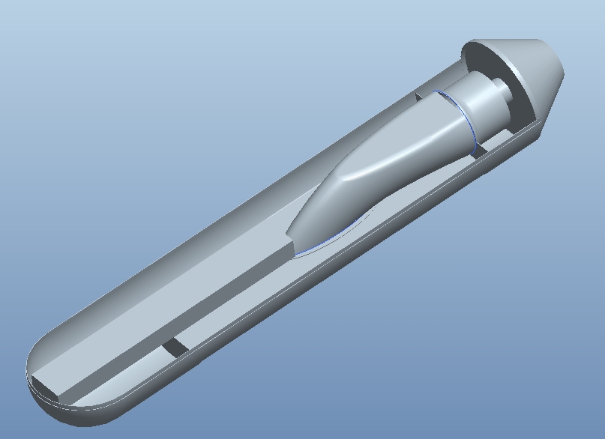
Assembled View
Exhaust Cap
Internal Duct
Battery
EDF

Slide 5
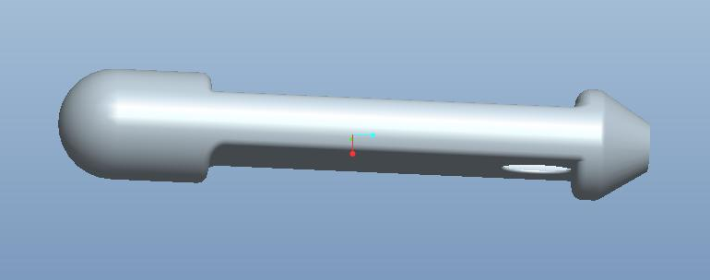
Coefficient of Drag and Lift
Drag Coefficient
Lift Coefficient

Slide 6
Static thrust test
Created a mount to hold fan
Connected the fan, speed control, receiver, and battery
Measured the change in weight

Slide 7
Static thrust test
Limitations | Results
Mount may limit air flow
Does not test dynamic conditions
Actual static thrust would be lower due to losses in friction of the fuselage
1.6 kg, 15.7N of thrust
Using actuator disk theory
T=ΔP*A
ΔP=3.97 kPa
T=ṁ*V
V=57.4 m/s
T=m*dV
To keep a certain thrust change the mass of air entering fan or change in velocity. At higher speeds have a smaller change in velocity across fan, which is why we need to maximize the amount of air fed to the fan.

Slide 8
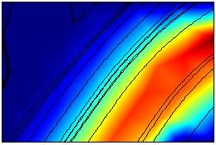
Inlet placement
Inlet far from fan | Inlet close to fan
Dark red=45 m/s
Losses due to friction
Higher efficiency
Dark red=60 m/s
High velocity entering fan
Lower efficiency
Efficiency:
As the change in velocity of the air by the fan increases the efficiency of the fan increases!

Slide 9
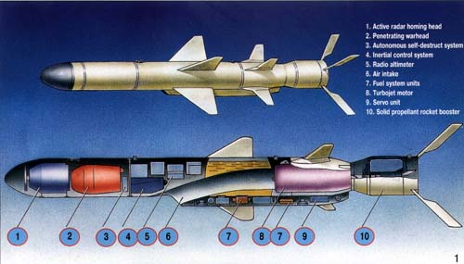
Why Intake at Bottom?
MAV designed to fly at high angles of attack
Intake at top not possible
Intake at sides not economically efficient
EXAMPLE: Cruise Missiles

Slide 10
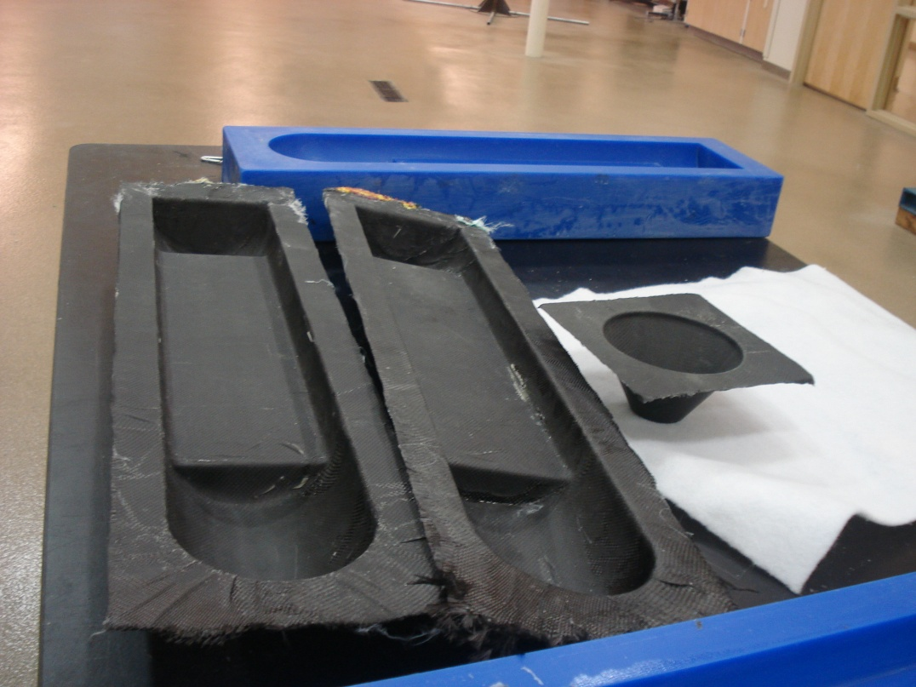
Weight analysis
Component | Weight (lbs.)
EDF | 0.862
Battery | 2.2128
ESC | 0.242
Transmitter/ Receiver | 0.033
Top half | 0.784
Bottom half | 0.775
End cap | 0.1780
TOTAL | 5.087

Slide 11
Cost Analysis
Component | Cost ($)
EDF | 129.95
Battery | 509.99
Battery Charger | 109.98
Woodworks LipoSack (Storage) | 34.99
ESC | 120.00
Transmitter/Receiver | 179.97
Industrial Strength Velcro | 7.00
Connection Wires | 14.00
TOTAL | $1105.88
Allocated Budget: $2000
Remaining Balance: $894.12

Slide 12
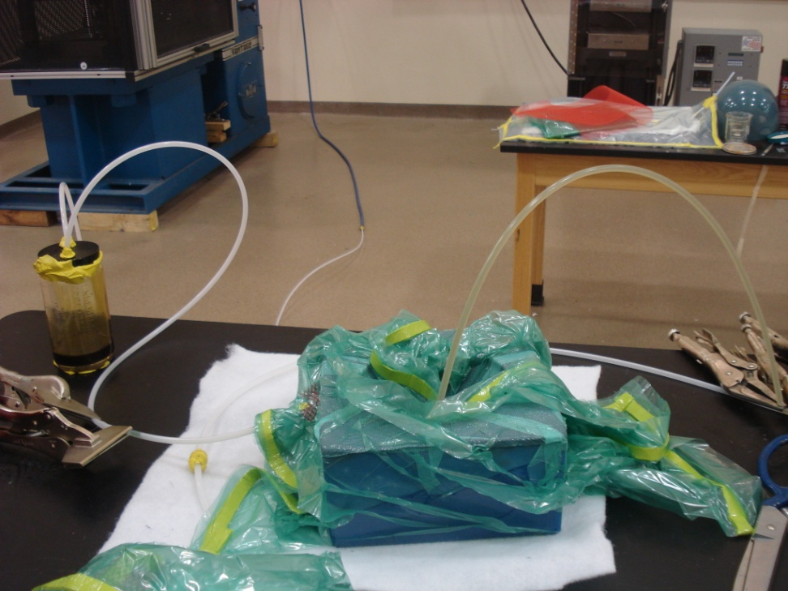
Vacuum Bagging Process
Carbon Fiber-Reinforced Polymer
635 Thin Epoxy Resin System
Materials provided by HPMI
Mold created by sponsor

Slide 13
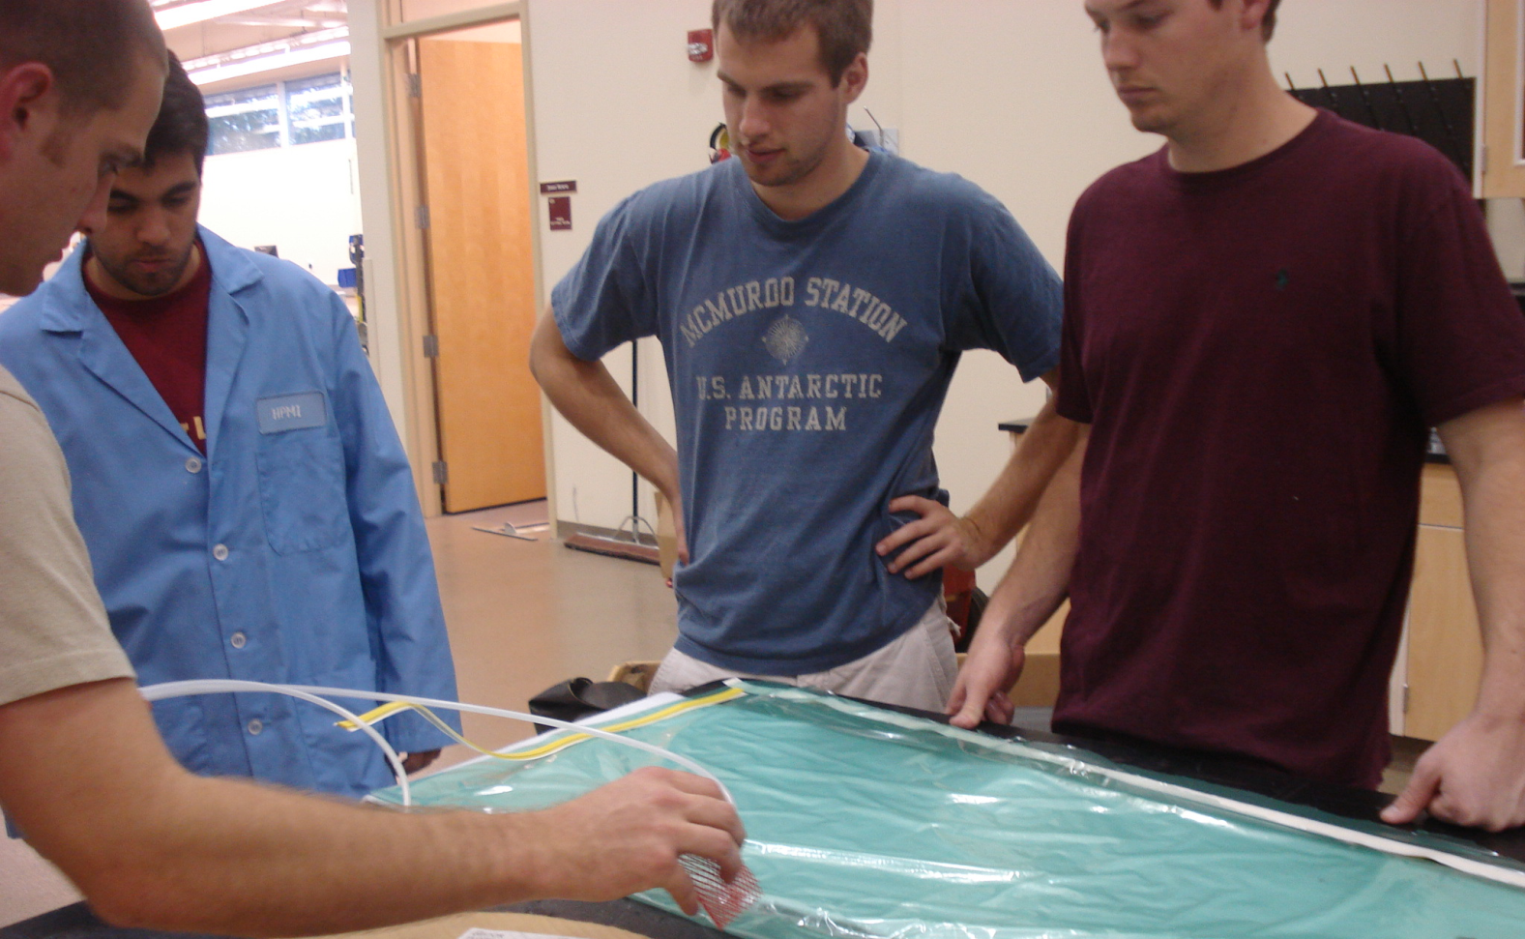
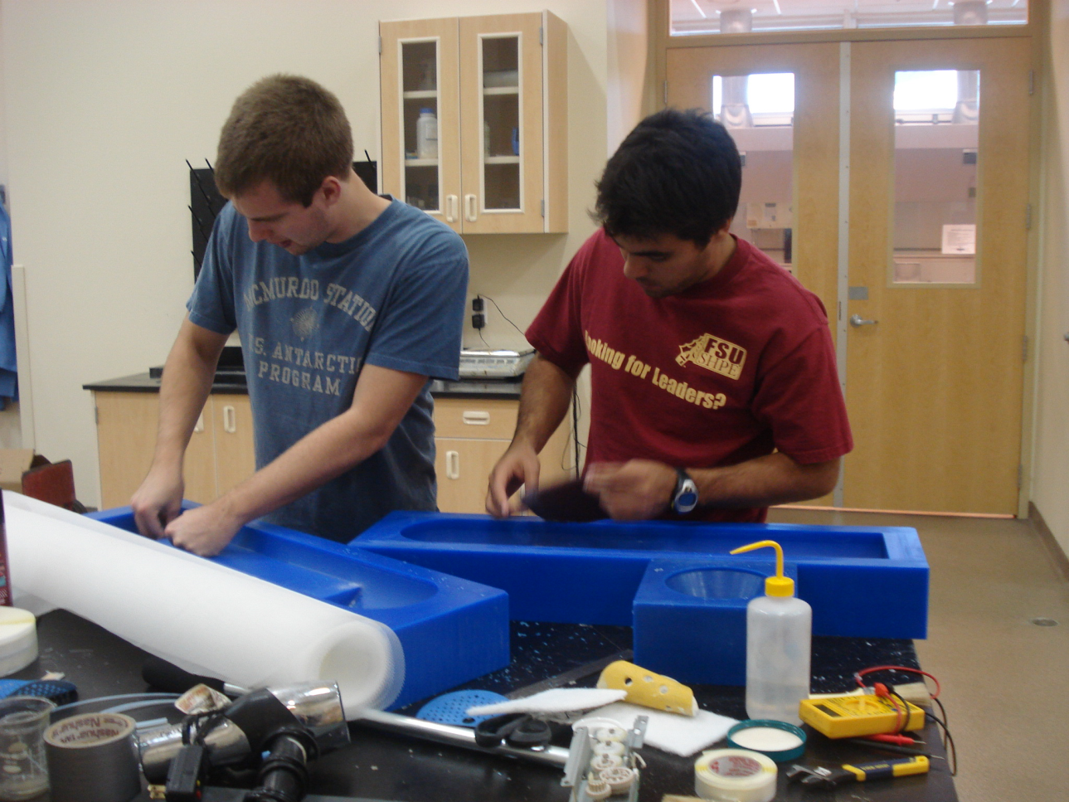
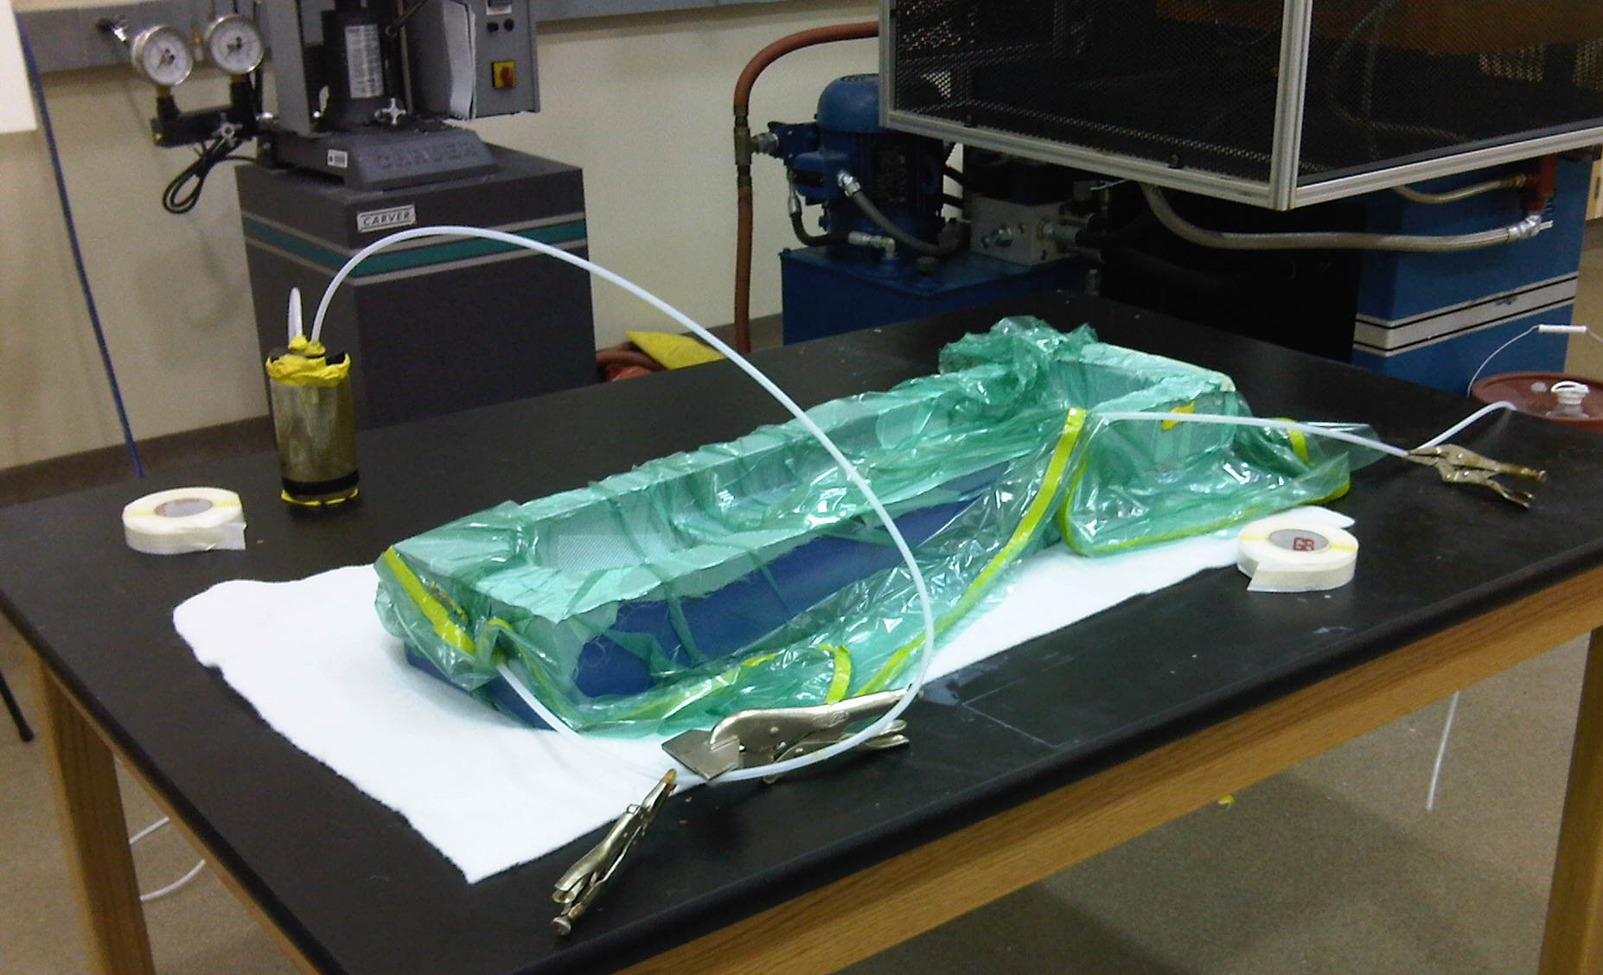
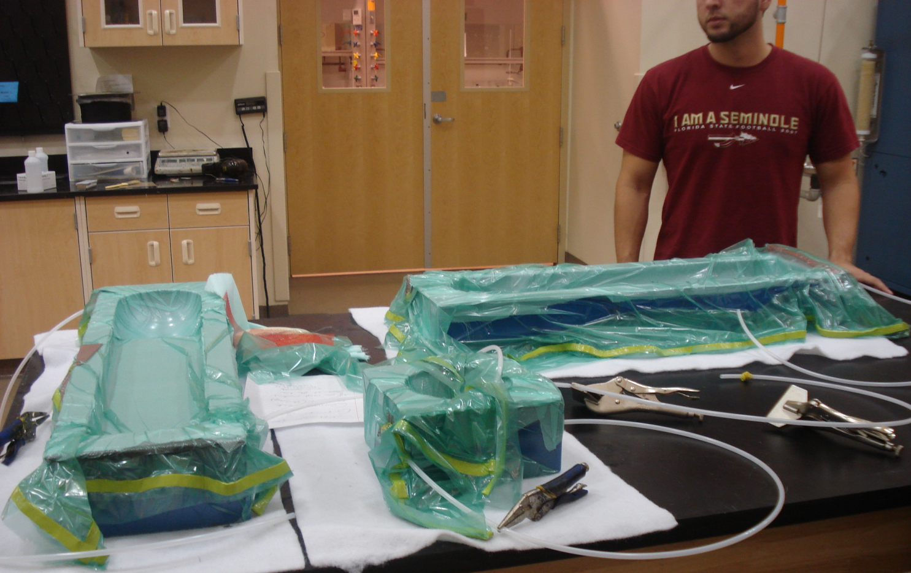
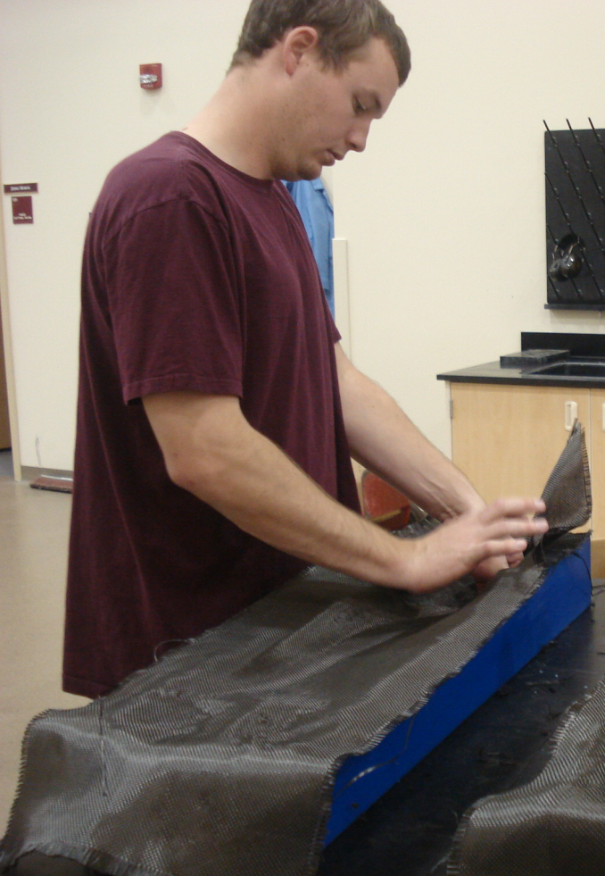
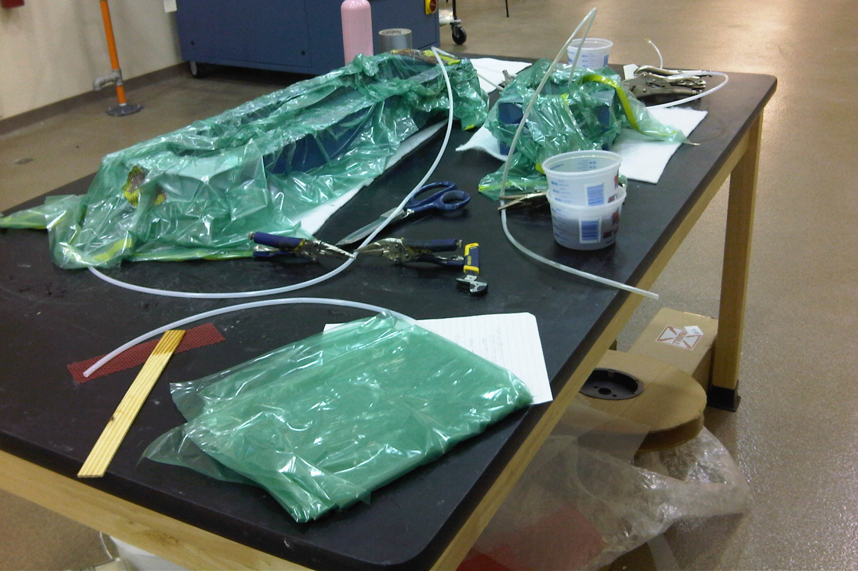
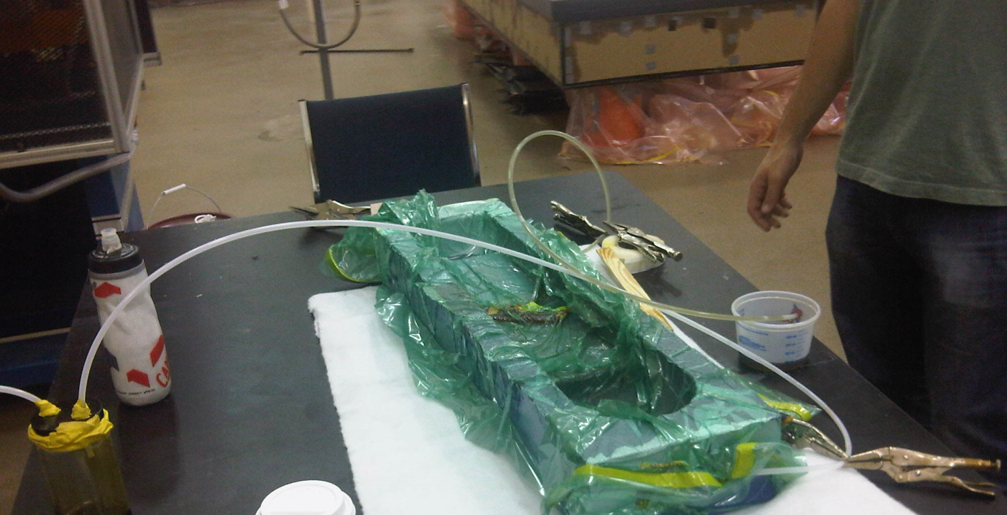
Vacuum Bagging Step by Step
Prepare materials needed
Apply mold release, carnauba based paste wax
Place carbon fiber, peel ply and flow media over mold
Place vacuum tube in desired location
Place vacuum bag over the mold and seal it
Turn vacuum pump on and begin evacuating air from the bag
Allow pressure to build up and observe for any leaks
If no leaks after 24 hours, begin infusion process
Allow 24 for laminate to cure
Separate laminate from the mold
Step 1
Step 2
Step 3
Step 4
Step 5
Step 6
Step 7
Step 8
Step 9
Step 10

Slide 14
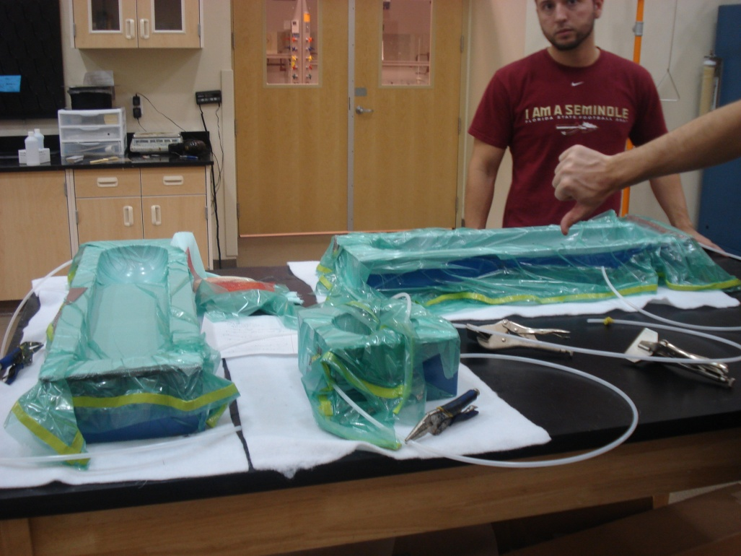
Manufacturing Complications
Resin deposits
Size/type of flow media
Points of infusion
Fuselage
Duct
Leaks in vacuum bag
Laying of the fibers

Slide 15
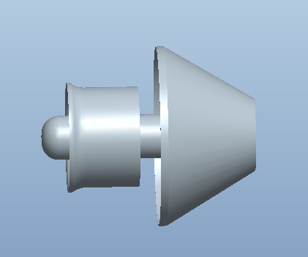
Redesign of Internal Duct
PROBLEM: Fuselage geometry constraints restrict approximately 20% of the airflow through fan
SOLUTION: Move fan backwards
Constant cross-section
vs. constant area
≈ 3 in.

Slide 16
Failure Mode and Effect Analysis

Slide 17
Risk Assessment
Access to Wind Tunnel
Use a fan and pitot static tubes to measure velocity
Time
Use of schedule and Gantt chart
Will not fly
Careful calculations and input from various sources with experience
Maybe too light weight with chosen fan
Add a payload

Slide 18
Schedule (What is left to do)

Slide 19
Resources
"76mm Aluminum Alloy Electric Ducted Fan." Nitro RC Planes, Inc. 2010. Web. 05 Oct. 2010. <http://www.nitroplanes.com/lealalel76du.html>.
Çengel, Yunus A., and Robert H. Turner. Fundamentals of Thermal-fluid Sciences. 3rd ed. Boston: McGraw-Hill, 2001. Print.
Draganfly Innovations Inc. RCToys.com Sells RC Airplanes RC Blimps RC Helicopters & Parts. 2008. Web. 07 Oct. 2010. <http://www.rctoys.com/pr/category/rc-information/rc-hobby-parts-component-info/>.
"Electric Ducted Fan Jet." RC Hobby Universe Guide to RC Airplanes, Helicopters, Boats, Cars and Trucks! 2006. Web. 07 Oct. 2010. <http://www.rc-hobby-universe.com/electric-ducted-fan-jet.html>.
“Integrating GPS with MAVs.”<http://www.mil.ufl.edu/~number9/mav/>.
Marc De Piolenc, F. "Ducted Fan Design, Volume 1 (Revised)." Google Books. Web. 29 Nov. 2010. <http://books.google.com/books?id=YcAjcSSP4HMC&printsec=frontcover&dq=Ducted Fan Design Volume 1&source=bl&ots=WtfDi_ZHQZ&sig=4G6VIAKC63HnIZLlQMLFf56LTZ0&hl=en&ei=nYnoTID_GMP6lwewtLGcCw&sa=X&oi=book_result&ct=result&resnum=9&ved=0CEYQ6AEwCA#v=onepage&q=efficiency&f=false>.
“RC Hobby Universe.” <http://www.rc-hobby universe.com/electric-ducted-fan-jet.html>.

Slide 20
acknowledgements
1st Lieutenant Brewer
Dr. Hovsapian
Dr. Kosaraju
Dr. Okoli
Dr. Englander
Dr. Ordonez
Dr. Shih
Jerry Horne
Dr. Chuy
Dr. Ahmed
Thunder Power

Slide 21
questions

